Slide 1


Airbnb vs Hotels: Where will you stay?
Huma Ghiya, Omar Farag, Mary phillipuk, halak patel

Slide 2


Core Message / Hypothesis
Based on price and ratings, which is a more favorable option for lodging: Airbnb vs Hotel?

Slide 3

8 Destinations
New York | Beijing
Las Vegas | Paris
Los Angeles | Madrid
Sydney | Amsterdam

Slide 4
Core Message / Hypothesis Cont.
QUESTIONS FOR RESEARCH:
Does Location effect the price and ratings of Hotels vs Airbnb?
How do lodging fees differ city to city and neighborhood to neighborhood in the same city?
Which has a greater # of lodging listings in a single city: Airbnb vs Hotel
How do prices effect ratings in a single city?
FACTORS TO BE CONSIDERED:
Price
Ratings
Location: 8 major cities throughout the United State & Internationally
Density

Slide 5
Core Questions: Why they are important?
In order to answer the bigger question– “Based on price and ratings, which is a more favorable option for lodging: Airbnb vs Hotel?”– we need to ask additional questions.
Recap of research questions:
Locations effect on price and ratings of Hotels vs Airbnb?
Compare lodging fees differ city to city and neighborhood to neighborhood in the same city?
Greater # of lodging listings in a single city: Airbnb vs Hotel
In order to determine which is overall a better lodging choice: Airbnb vs Hotel, we must look at data to compare and contrast important factors an individual may consider before making a choice:
Location- We chose 8 major cities (US and Internationally) to compare how location effects prices and ratings
Price- We observed fees for both Hotels and Airbnb in different locations to research which location has the highest and lowest fees for lodging
Ratings – We observed how ratings differ for Hotels and Airbnbs and how ratings also differ for both in different cities and different neighborhoods within cities
Prices correlation with ratings

Slide 6

Questions and Data
Question | Data Needed | Data Source
Does Location effect the price and ratings of Hotels Vs. Airbnb | Airbnb data for pricing and ratings in 8 cities Density in 8 cities Hotel data for pricing and ratings in 8 cities Density 8 cities | Airbnb Data: http://insideairbnb.com/get-the-data.html Hotel Data: https://github.com/lucasmonteiro001/free-world-hotel-database/blob/master/hotels.csv.zip Tripadvisor
How do lodging fees differ city to city and neighborhood to neighborhood in the same city? | Airbnb data for pricing and ratings in 8 cities Density in 8 cities Hotel data for pricing and ratings in 8 cities Density in 8 cities | Airbnb Data: http://insideairbnb.com/get-the-data.html Hotel Data: https://github.com/lucasmonteiro001/free-world-hotel-database/blob/master/hotels.csv.zip
Which has a greater # of lodging listings in a single city: Hotel Vs. Airbnb? | Heat maps generated from Hotel and Airbnb data | Airbnb Data: http://insideairbnb.com/get-the-data.html Hotel Data: https://github.com/lucasmonteiro001/free-world-hotel-database/blob/master/hotels.csv.zip
How do prices effect ratings in a single city? | Airbnb data for pricing and ratings in 8 cities Hotel data for pricing and ratings in 8 cities | Airbnb Data: http://insideairbnb.com/get-the-data.html Hotel Data: https://github.com/lucasmonteiro001/free-world-hotel-database/blob/master/hotels.csv.zip

Slide 7

Data Clean-Up and Exploration: Airbnb
Inside Airbnb - http://insideairbnb.com/get-the-data.html
Data scraped and formatted periodically – it’s pretty clean!
Downloaded detailed listings csv files for each city (107 fields!) and geoJSON files
Keyed the data with additional fields (city identifier, location to geo center
Filtered for listings outside city latitude/longitude bounding box, but there were none (This site master is motivated!)
Dropped listings where Price = 0, Price missing, and Review Score missing
Made subset dataframes with only pertinent fields
Ultimately filtered to Double-Occupancy non-shared accommodations to compare with hotel data
245,864 raw listings for the 8 cities combined, down to 81,579 filtered

Slide 8
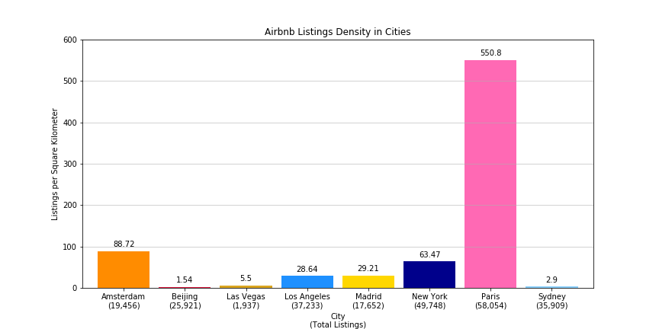
We didn’t expect…

Slide 9
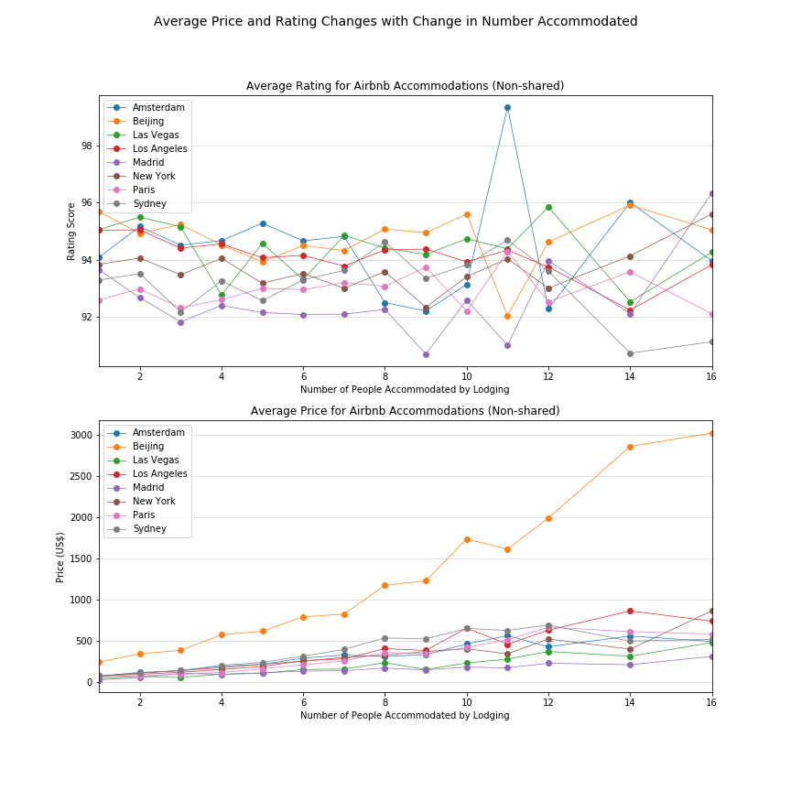
Airbnb Data
We thought we saw a downward trend with rating scores according to number of people accommodated…but we didn’t.
How average prices increased according to group size – Beijing likes to be different
We had to get used to computing quartiles and setting axis limits because there were a lot of expensive outliers

Slide 10
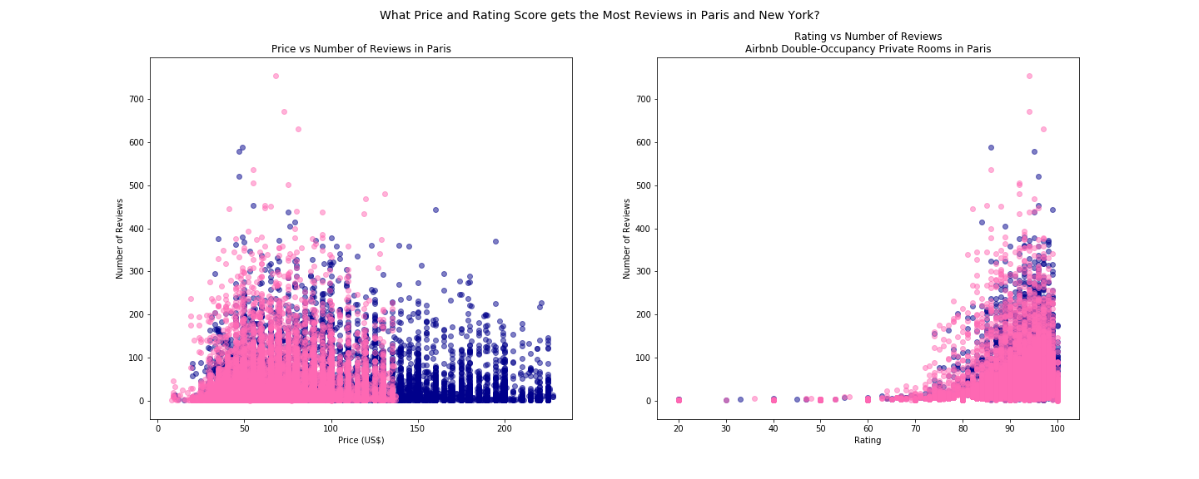
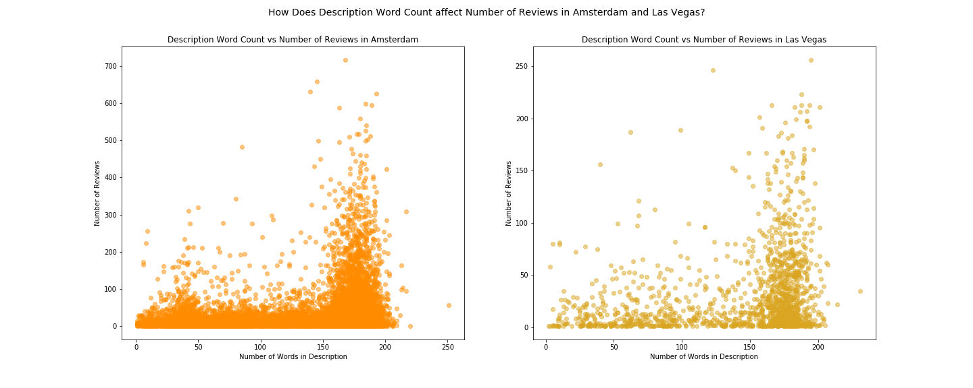
Airbnb – Scatter crazy
When given a big dataset, it can be hard to stop plotting.
We asked, what factors influence where people choose to stay?
Top Row: Price and Rating
Bottom Row: Word Count in Description

Slide 11
Data Clean-Up and Exploration - Hotels
World Hotel Dataset .csv- https://github.com/lucasmonteiro001/free-world-hotel-database/blob/master/hotels.csv.zip,
Smaller amount of data per city, dated 2016
Unknown original source from which data was aggregated
Unspecified monetary units
Dropped listings where Price = 0, Price missing, and Review Score missing
Used for geographical coordinates/heat map
TripAdvisor https://www.tripadvisor.com
Scraped using python script March 28, 2019
Saved @ first 1000 listings available for each city, though many cities had fewer listings on that date
Dropped listings where Price = 0, Price missing, and Review Score missing
No readily available map data

Slide 12
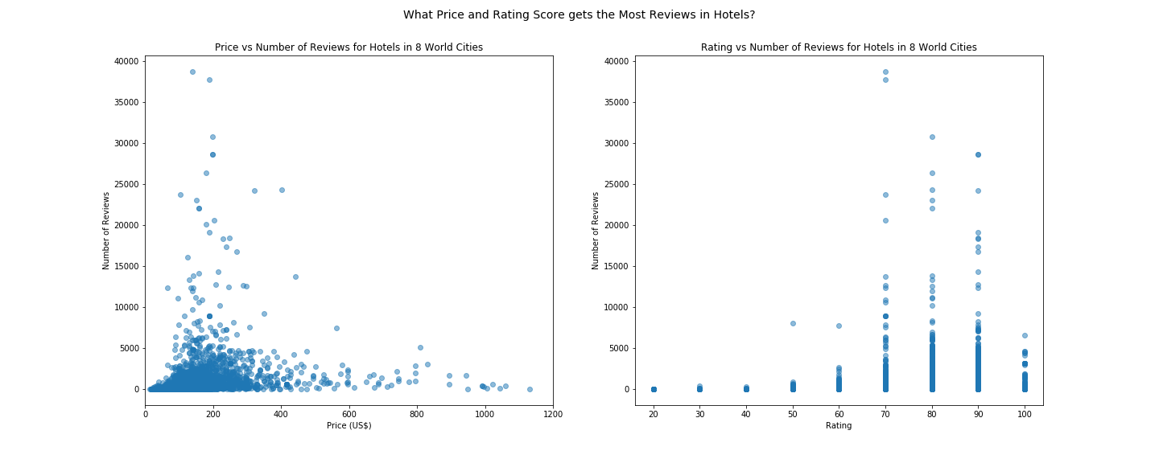
Hotel data on a different scale – Less data points per city, and less granular review scores

Slide 13
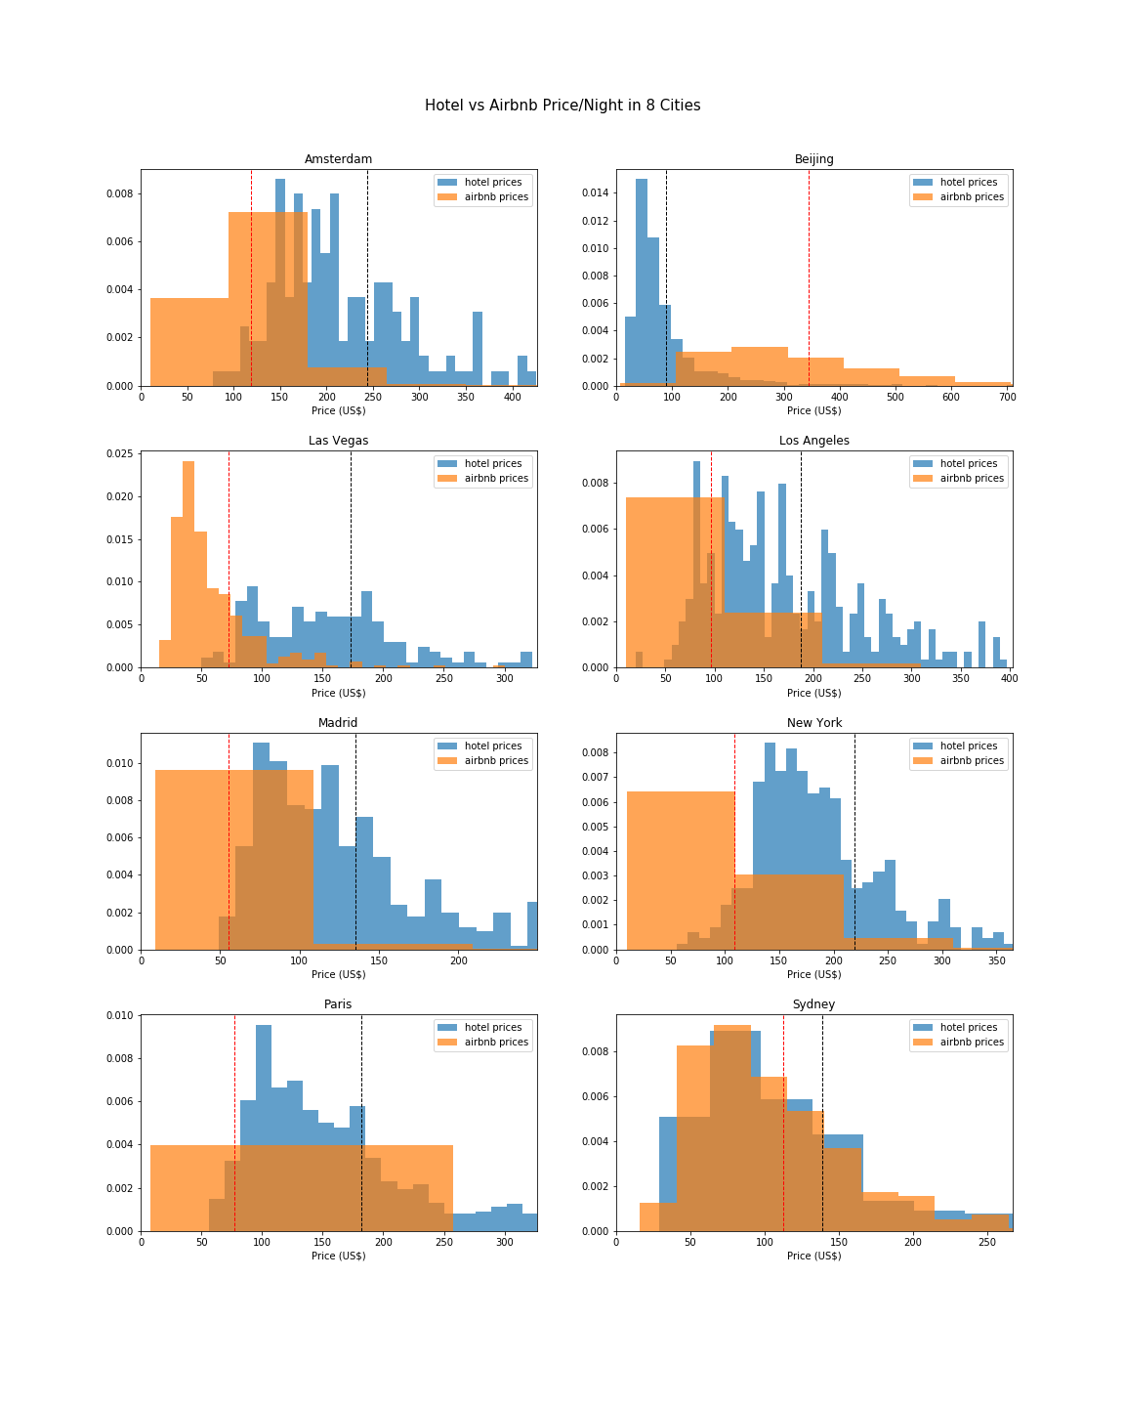
Hotel data –
One (or more) of these cities is not like the other…
We expected the same results, but one of these cities actually passed its t-test!
(Hotel and Airbnb prices about the same on average)

Slide 14
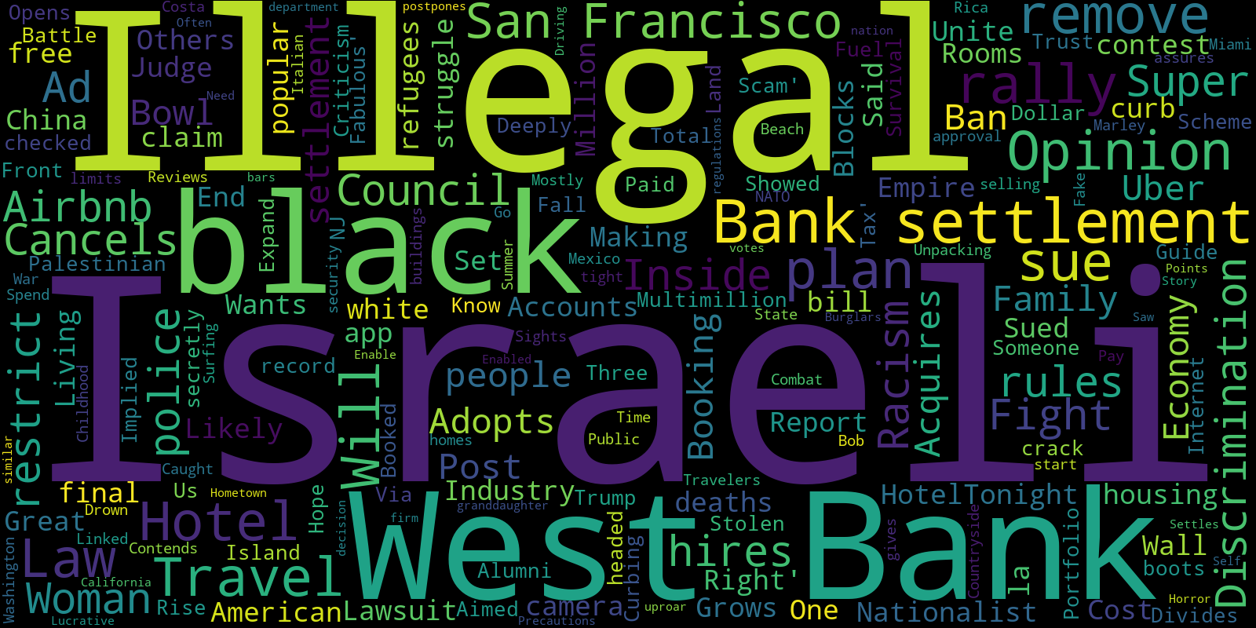
Other – Airbnb Word Cloud from Google Custom Search API and 12 major news sites

Slide 15
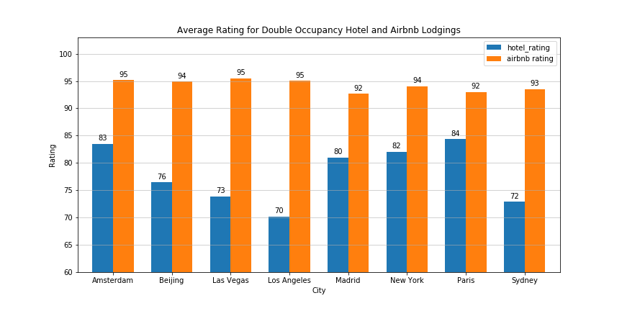
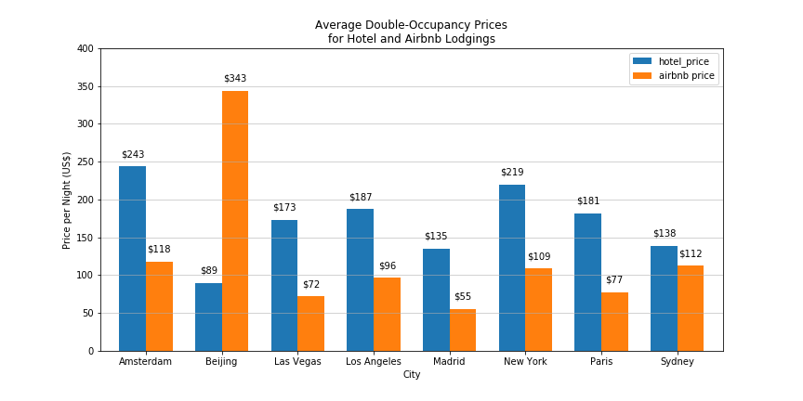
Data Analysis: Airbnb Vs. Hotel

Slide 16
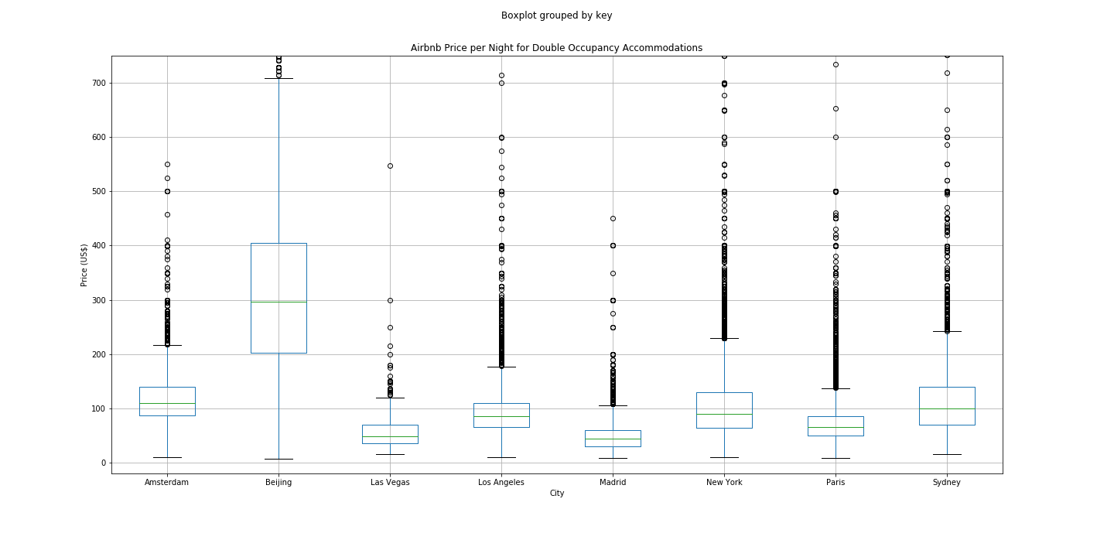
Airbnb: Price Analysis

Slide 17
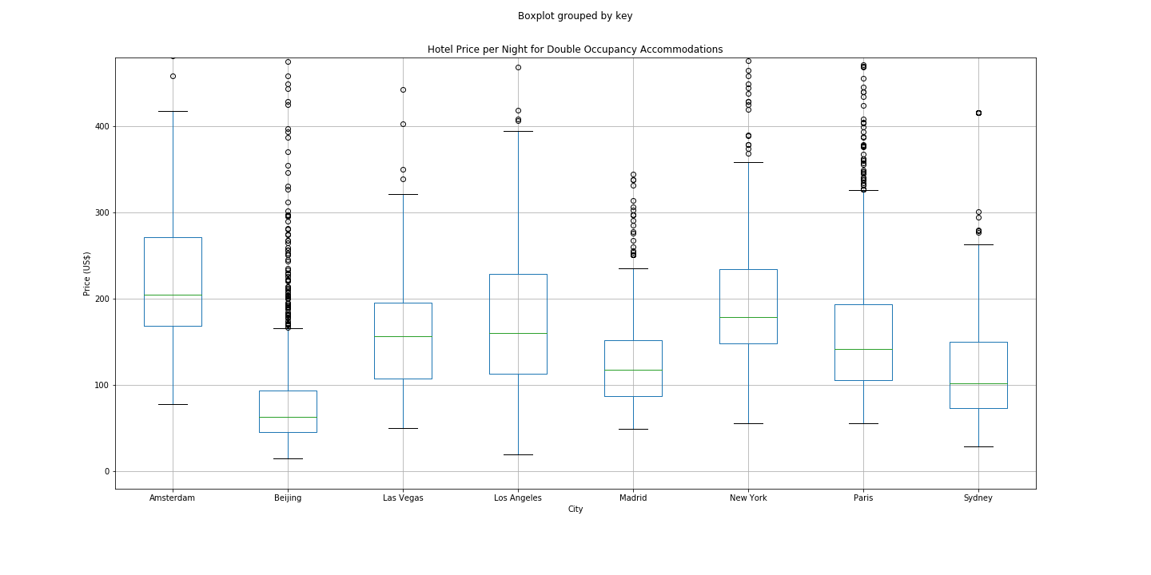
Hotel: Price Analysis

Slide 18
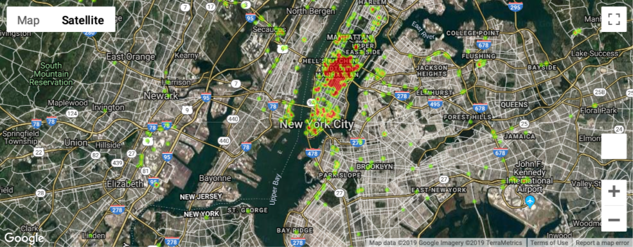
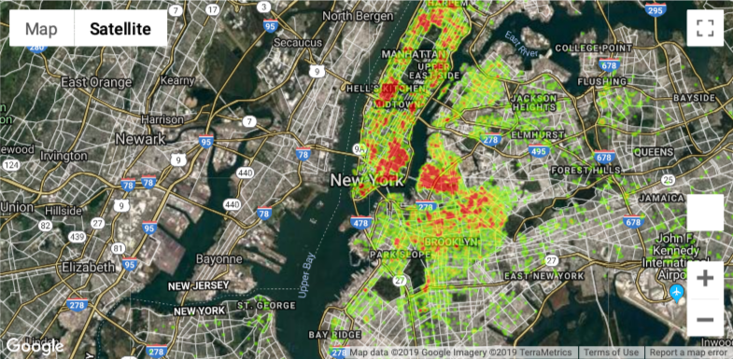
New York Heat Maps
Hotel locations concentrated in Midtown
Airbnb locations more widespread with hipster neighborhood price concentrations showing in

Slide 19
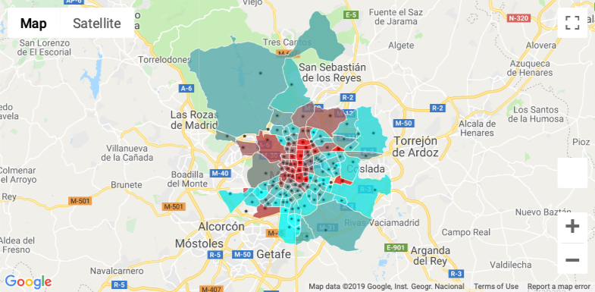
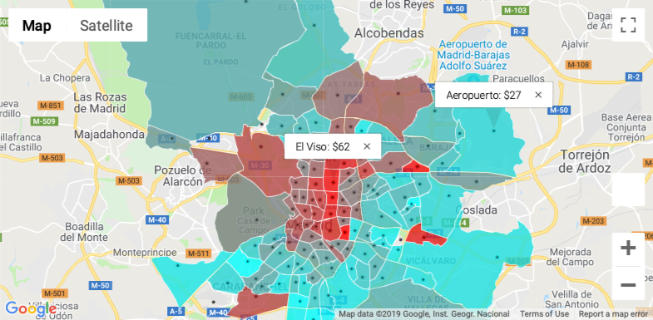
Madrid Chloropleth
Color-coded neighborhoods:
Higher average prices at central locations

Slide 20
Discussion
Discussion of our findings:
Due to popularity, high-demands, and prices we were expecting to find that Airbnbs would be a more favorable option of lodging as compared to hotels.
Upon our research and data analysis, we came to the conclusion that Airbnb indeed is a more favorable lodging option in most cities based upon prices and ratings.
Airbnb has lower prices than hotels in 6 out of 8 cities, and higher ratings in all. These higher ratings may be due to the increased granularity of the Airbnb rating scale (score out of 100 vs out of 5) and the fact that the Airbnb market relies heavily on reviews.

Slide 21

Vacation Destination…
Based upon our research and data analysis, we have decided to go to:
MADRID
Madrid had the lowest Airbnb prices after Las Vegas and also had relatively high ratings making it the most optimal spot for our vacation trip

Slide 22
Post Mortem
Difficulties that arose and how we dealt with them:
We were unable to uncover a comparably large and detailed amount of Hotel Data
Difficulty accessing travel business affiliated Hotel APIs
Additional questions / thoughts:
We would have liked to consider what policies are in place in each city that may affect the price and availability of lodging types
If we had more time, we would analyze additional data that may effect which of the two lodging options is the optimal choice by looking at factor such as: Amenities, Extra services offered, Group size, and transportation
If we had two more weeks, we would analyze data for the distance between Hotels, Airbnbs and attractions in each city
Conduct a qualitative assessment of other factors such as community, housing data, number of jobs, Airbnbs effect of hospitality industry
Airbnb is better for price and customer rating, but is it really better for cities and communities?

Slide 23

Q&A

